Slide 1
www.MINEPORTAL.in
ONLINE TEST SERIES FOR
DGMS COAL/METAL FIRST/SECOND CLASS EXAM
GATE MINING EXAM
OVERMAN EXAM TEST
MINING INSPECTOR EXAMS
COAL INDIA MTs & OTHER PSUs EXAMS
FREE STUDY MATERIAL & VIDEO LECTURES
MINING JOBS NOTIFICATIONS
www.mineportal.in Call/Whatsapp-8804777500 www.fb.com/mineportal.in

Slide 2
For blasting off the gallaries different types of cuts are used.
Wedge cut/V cut,Pyramid/Diamond cut,Drag cut,Fan cut are generally used for the blasting off the weaker rocks as compared to that of Burn cut which is uused for tougher rocks like granite,basalt.

Slide 3
In any blasting hole a common pattern is followed to charge it up.
So any hole’s 2/3 part is fillled with the explosive material and upper rest part is filled with stimming material as it provides free space for the explosive which adds to the efficiency of explosive.

Slide 4
We can calculate the no. of holes to be drilled roughly with the help of powder factor as the powder factor is somewhat definite for a certain region.
Powder factor=
weight of rocks expoided(tonnes)/Weight of explosive(kg)

Slide 5
For exlplosive weight we first find out the volume of the block we are going to explode.
Now it is multiplied by density of material which is surely known.
Now no. of holes multiplied by explosive in each hole.

Slide 6
Now reversing this formula we get no. of holes to be done.
Then by hit and trial we can adjust it also.

Slide 7
MUCKING IN MINES
Loading of the exploided material/excavative materials is known as mucking.it is mechanised in mines.
For coal mines generally two types of machineries are used.
SDL-Side discharge loader
LHD-Load Haul Dump

Slide 8
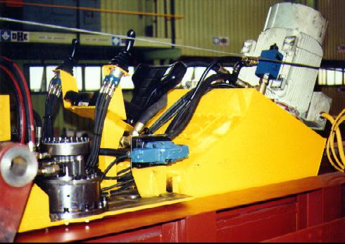
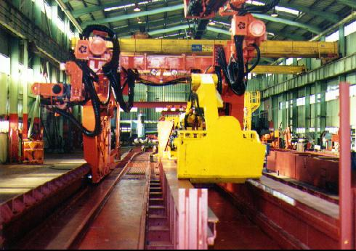
M.M.S. (mechanised mucking system)
excavator controls & power pack
excavator in ‘park’ position under jumbo

Slide 9
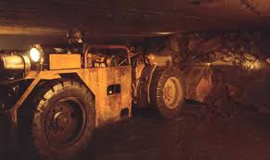
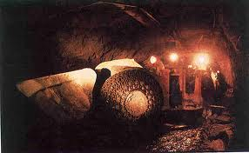
Load haul dump

Slide 10
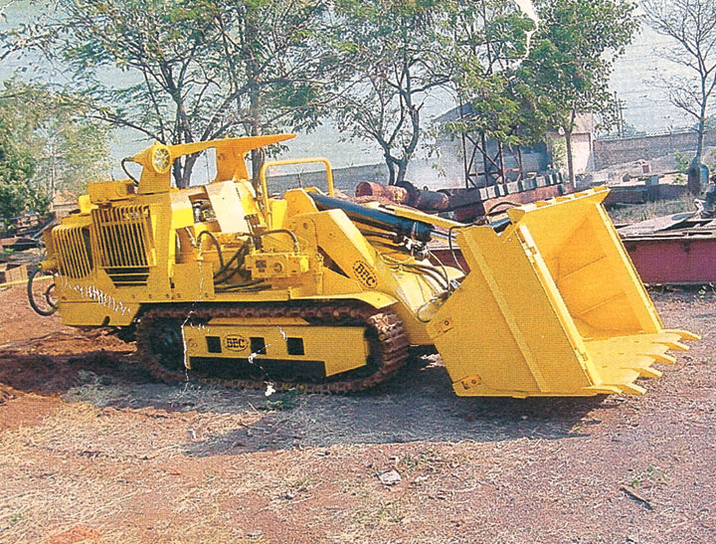
Side discharge loader

Slide 11
Swadesh kumar
Roll no 10108en 021
Mining engg.

